Slide 1
Signal Energy and Power
calculations

Slide 2

Energy Signal and Power Signal
The terms signal energy and signal power are used to characterize a signal. They are not actually measures of energy and power. The definition of signal energy and power refers to any signal x(t), including signals that take on complex values.
The signal energy in the signal x(t) is:

Slide 3

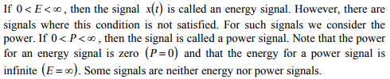
The signal power in the signal x(t) is:

Slide 4
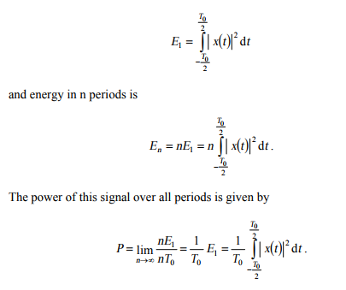
Let us consider a periodic signal x (t) with period To.
The signal energy in one period is

Slide 5
If the signal energy over one period is larger than zero but finite, then the total energy is infinite and the signal power is finite. Therefore, the signal is a power signal. If the signal energy in one period is infinite, then both the power and the total energy are infinite.
Consequently, the signal is neither an energy signal nor a power signal.

Slide 6
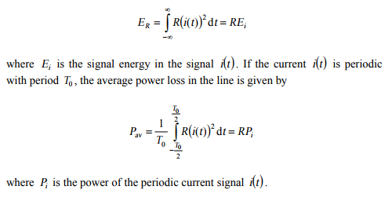
Consider a current signal i(t) flowing through a transmission line represented by resistance R. The energy loss in the line is:

Slide 7
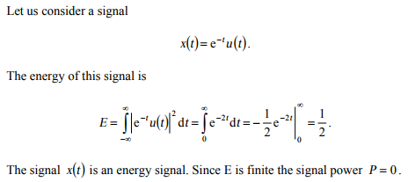
Example 1: -

Slide 8
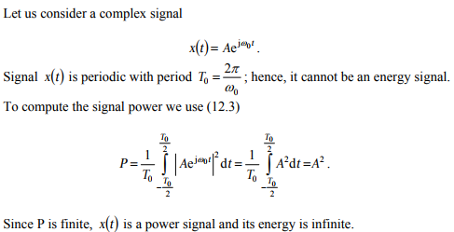
Example 1: -

Slide 9


Parseval's Theorem
If a function has a Fourier series given by
then Bessel's inequality becomes an equality known as Parseval's theorem. From above equation:

Slide 10
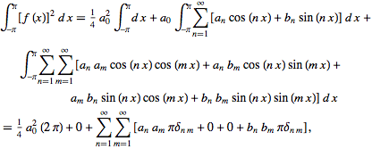
Integrating

Slide 11

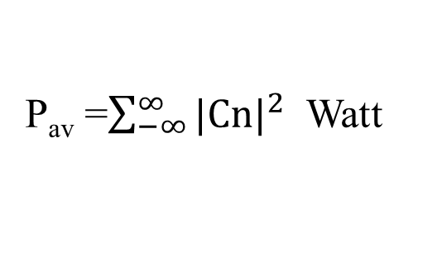
so
For a generalized Fourier series of a complete orthogonal system , an analogous relationship holds.
For a complex Fourier series,
P_{av} =$\sum_{−∞}^{∞}{{|Cn|}^{2}}$ Watt

